Slide 1
LUNA
The Mental Health Assistant
By B. Ganesh 012
M. Nikhil 025
J. Shyam 042

Slide 2
Contents
Abstract: | Provides basic idea of our project
Project Description: | Provides a basic view of working
Project Features: | Features that the project provides
Use Case Diagram: | Use case diagram of the project
Technologies Used: | Different technologies used in the project

Slide 3
1 Billion
In 2019
were living with a mental disorder.

Slide 4
Motivation
Most people know it's important to take care of your physical health, but not everyone knows it's equally important to take the time to address their mental health needs. Learning how to handle stress and make time for yourself are just as important as eating right and exercising. All of these things are aspect of self-care and can help people live their healthiest lives.

Slide 5
Abstract
This is an emotional health assistant website developed by a team of engineers. It is designed to help users beat anxiety and depression, calm their minds, sleep better, be happier, and how to maintain their emotional and physical health. It uses artificial intelligence (A.I.) to personalize various techniques and incorporates strategies from Cognitive Behavioral Therapy, Acceptance and Commitment Therapy, Mindfulness, and other approaches to be a useful tool.

Slide 6
Project Description
This app interacts with the user with the help of the journal they write.
The app analyzes the journal written by the user.
It suggests different ways to improve their sleep schedule.
It helps the user utilize their time in a better way.
It helps the user to approach things positively.
Helps the user set goals and achieve them accordingly.

Slide 7
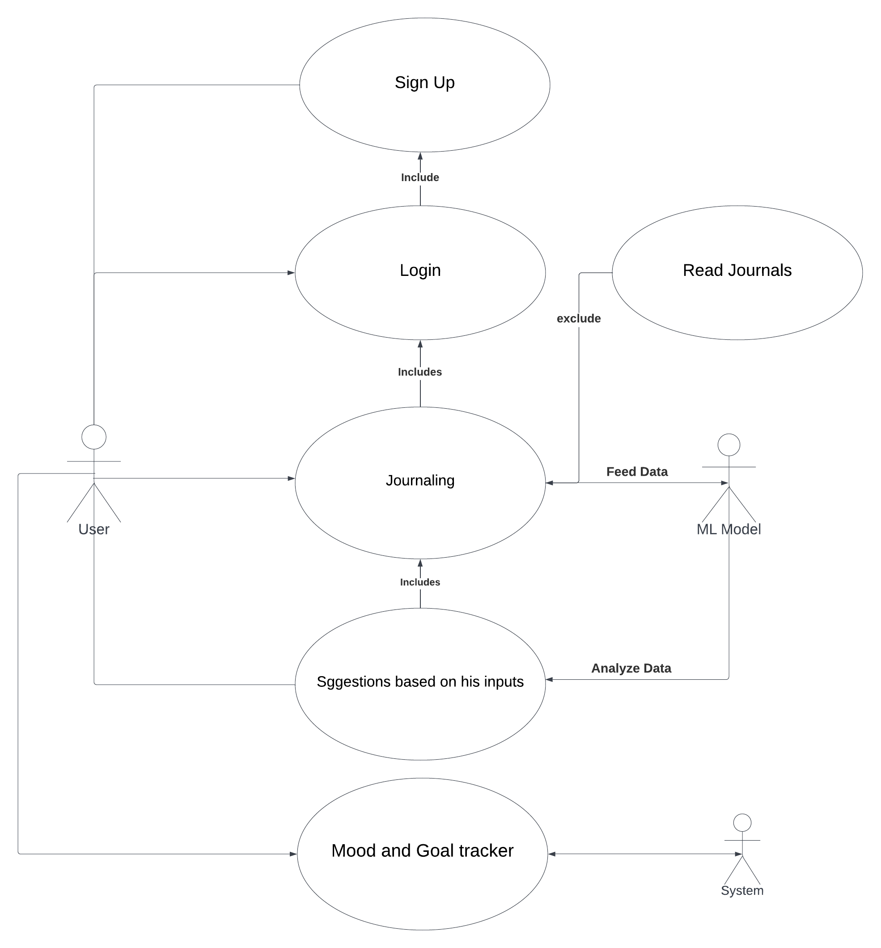
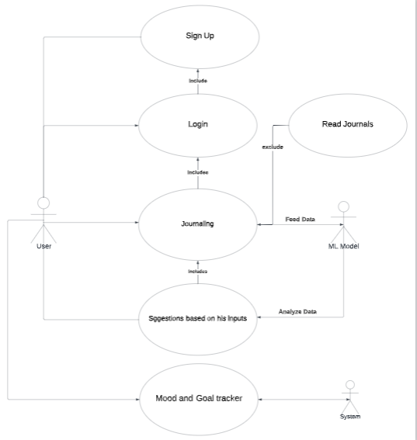
Use Case Diagram

Slide 8
USE CASE-1
NAME : Mood Tracker
ACTORS INVOLVED: User
DESCRIPTION : Tracks the mood of the user based on the Input
PRE CONDITION : Logged in
POST CONDITION : Data saved in database

Slide 9
USE CASE- 2
NAME : Journal
ACTORS INVOLVED : User DESCRIPTION : Saves Journal of the user
PRE CONDITION : Logged in user
POST CONDITION : Saved in database, will be feeded to ML
algorithm

Slide 10
Recommendation System
Journaling
1
Feeding Data to ML Model
4
2
Recommendations
Analyzing Data
3

Slide 11
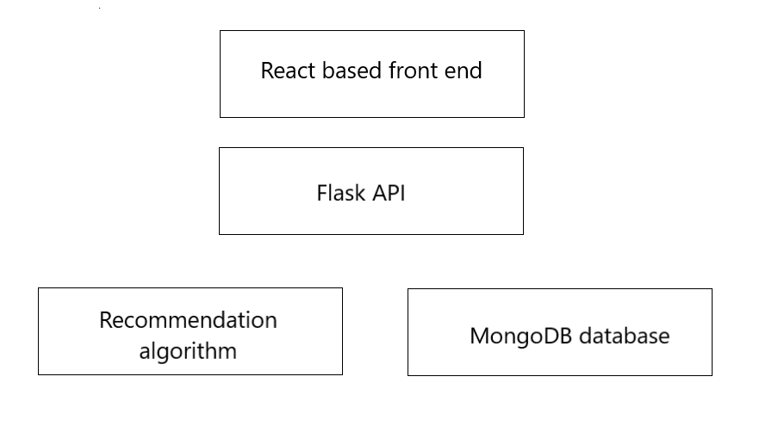
Tech-Stack

Slide 12
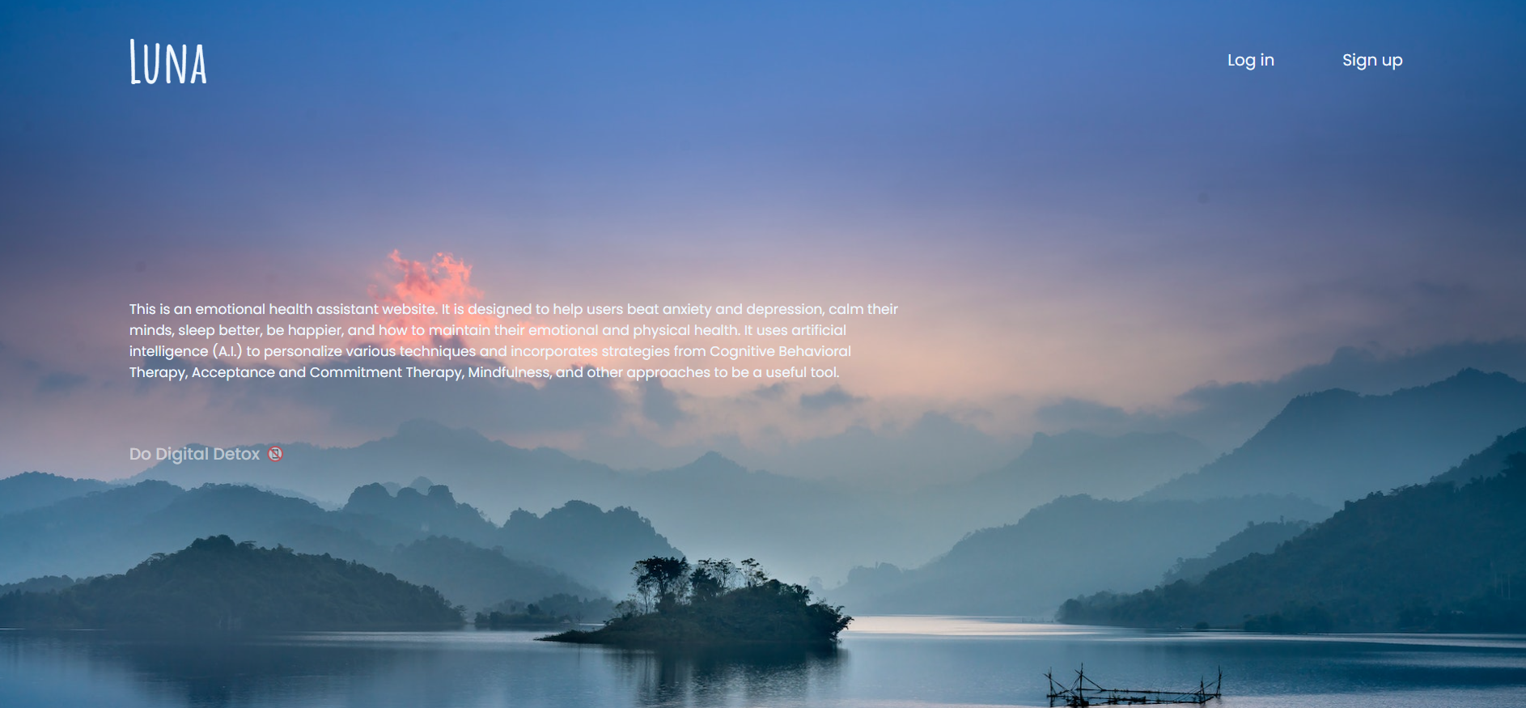
Screenshots

Slide 13
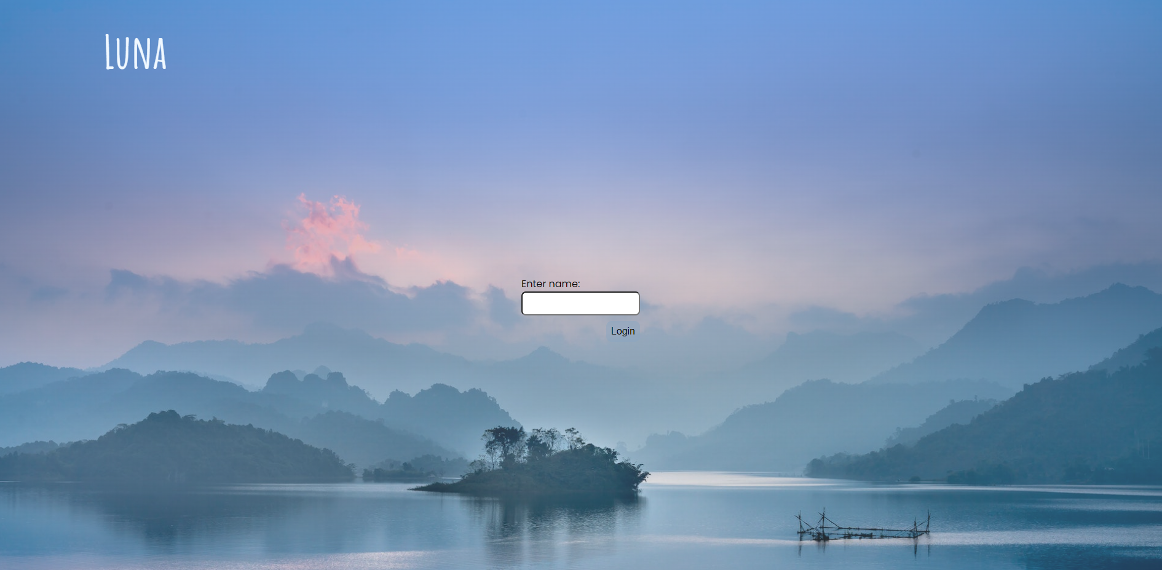
Screenshots…

Slide 14
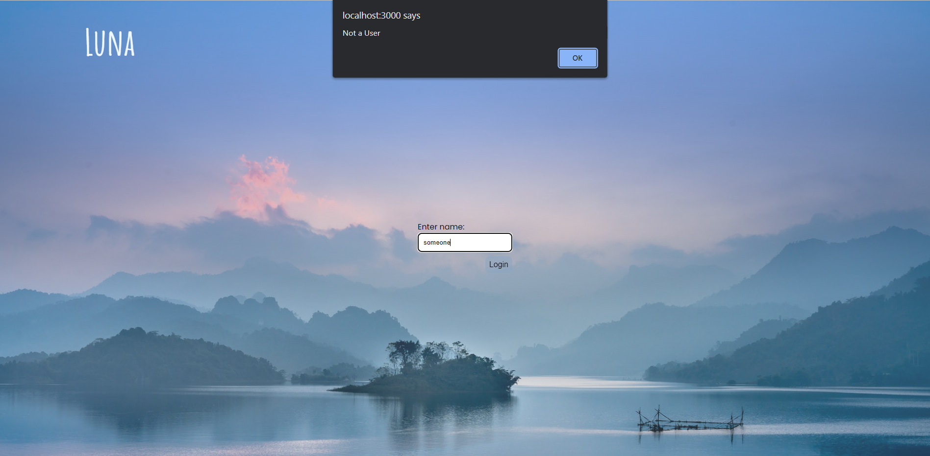
Screenshots…

Slide 15
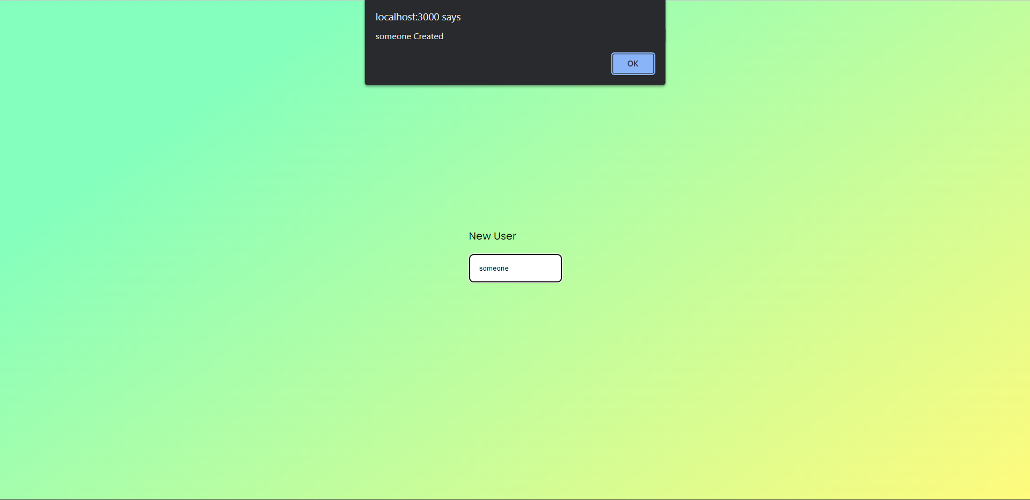
Screenshots…

Slide 16
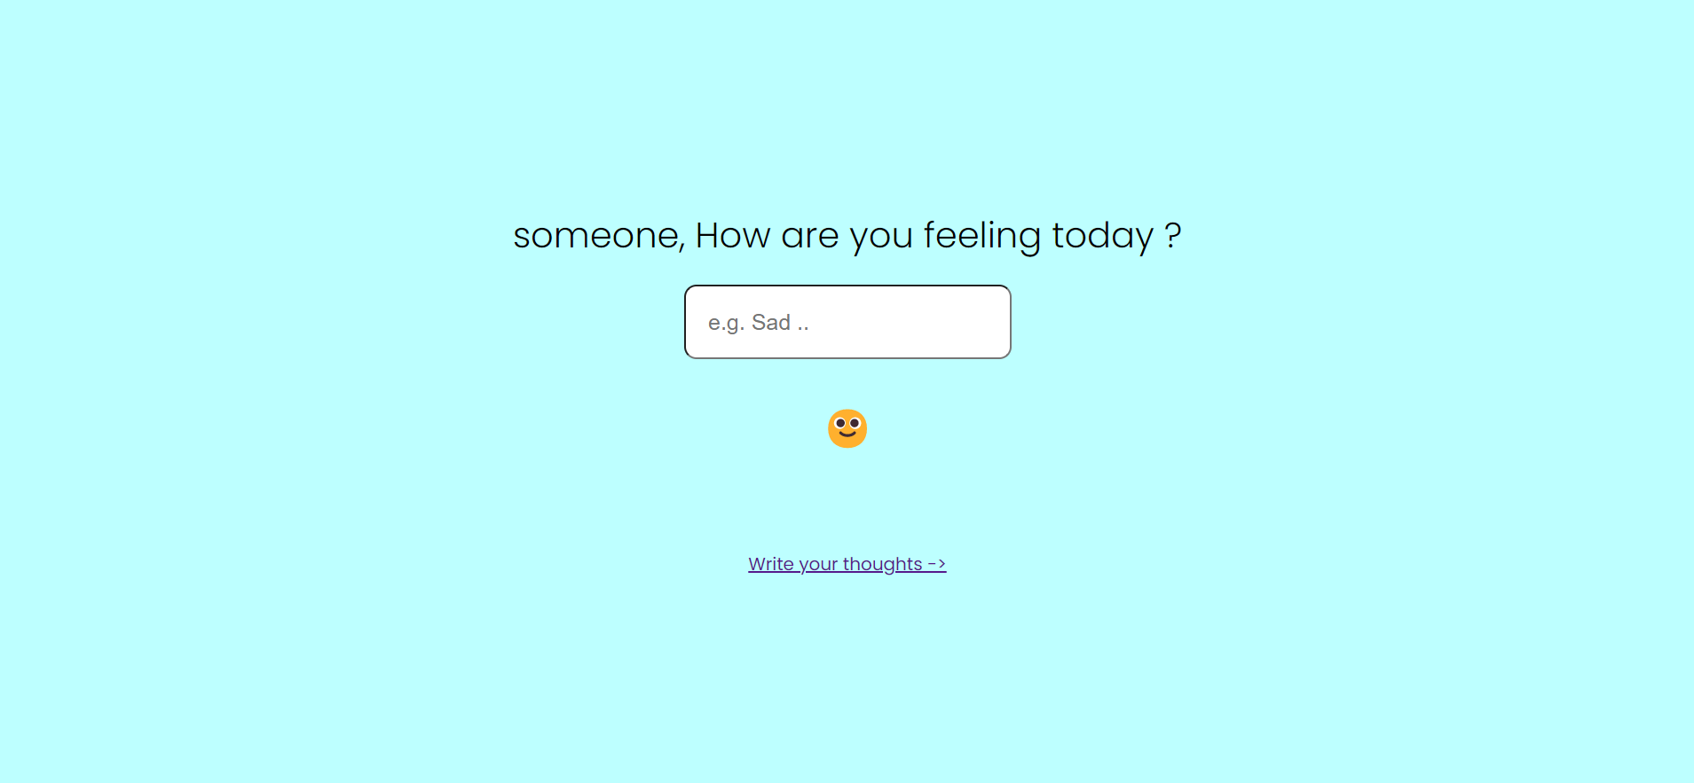
Screenshots…

Slide 17
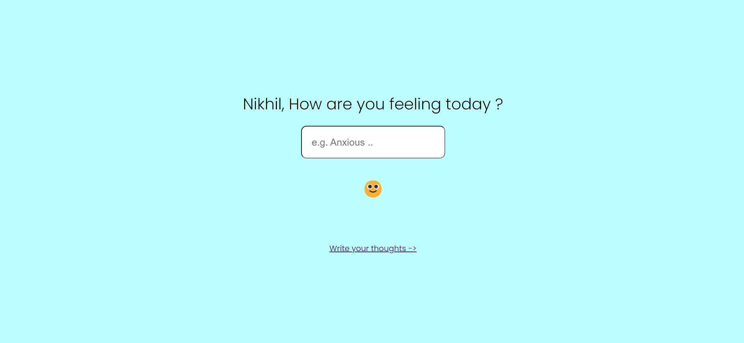
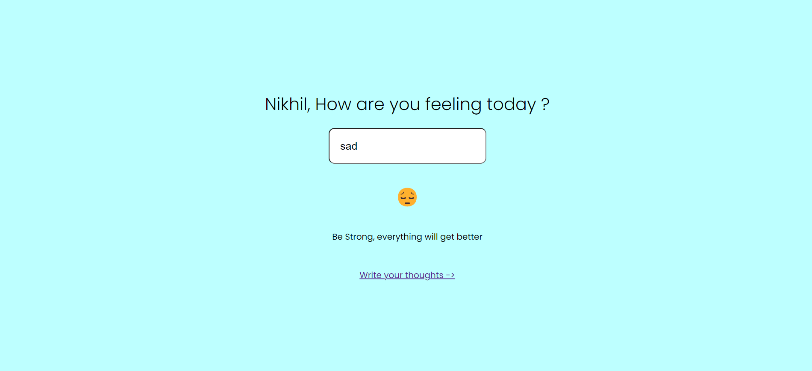
Screenshots…

Slide 18
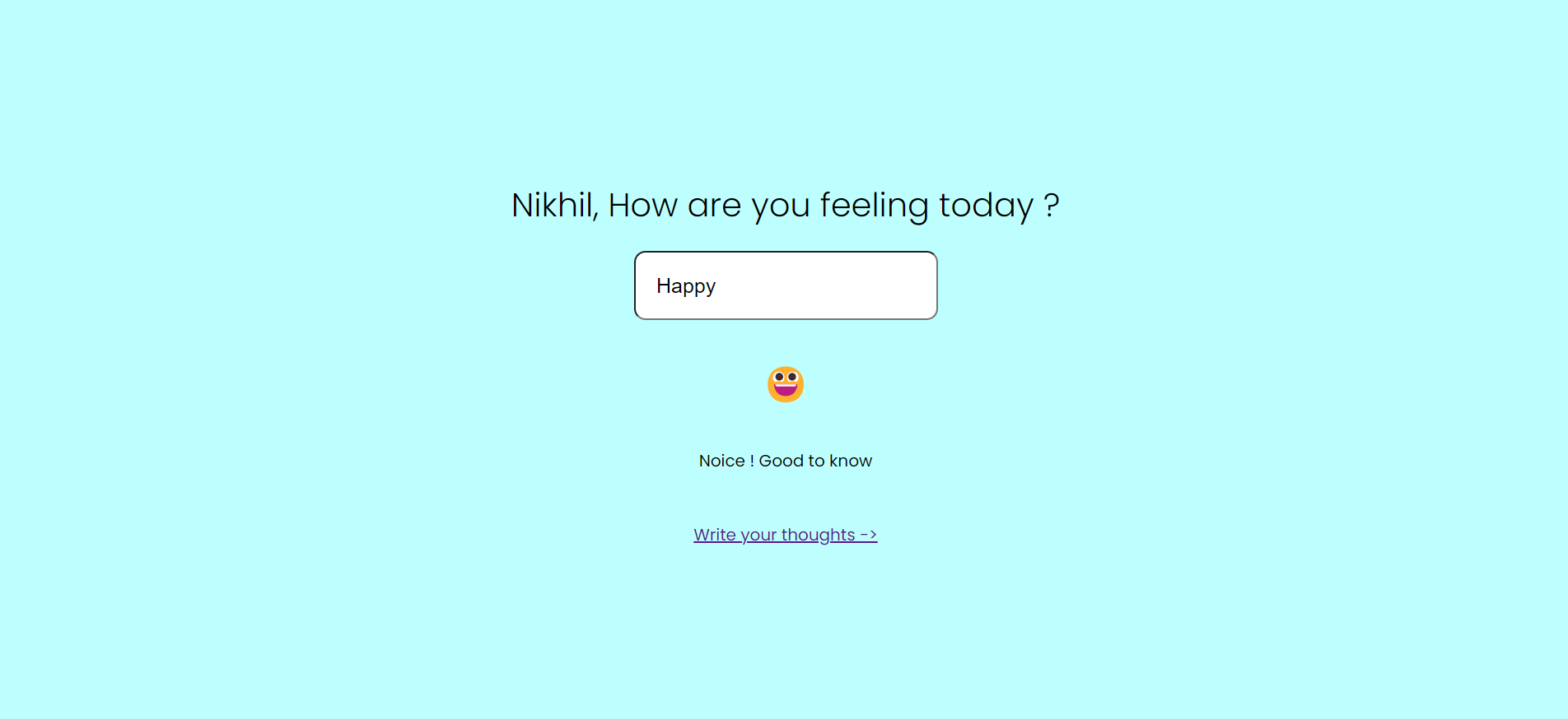
Screenshots…

Slide 19
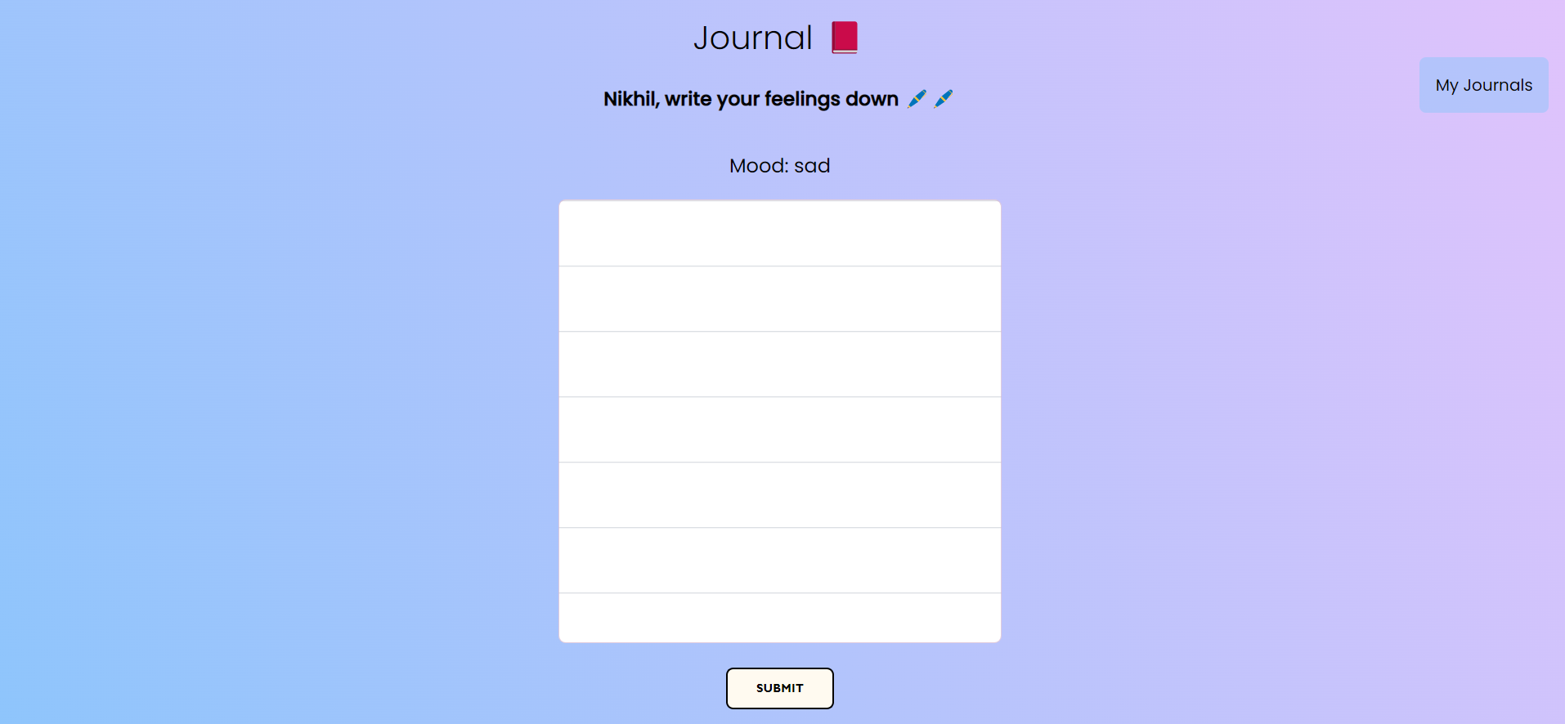
Screenshots…

Slide 20
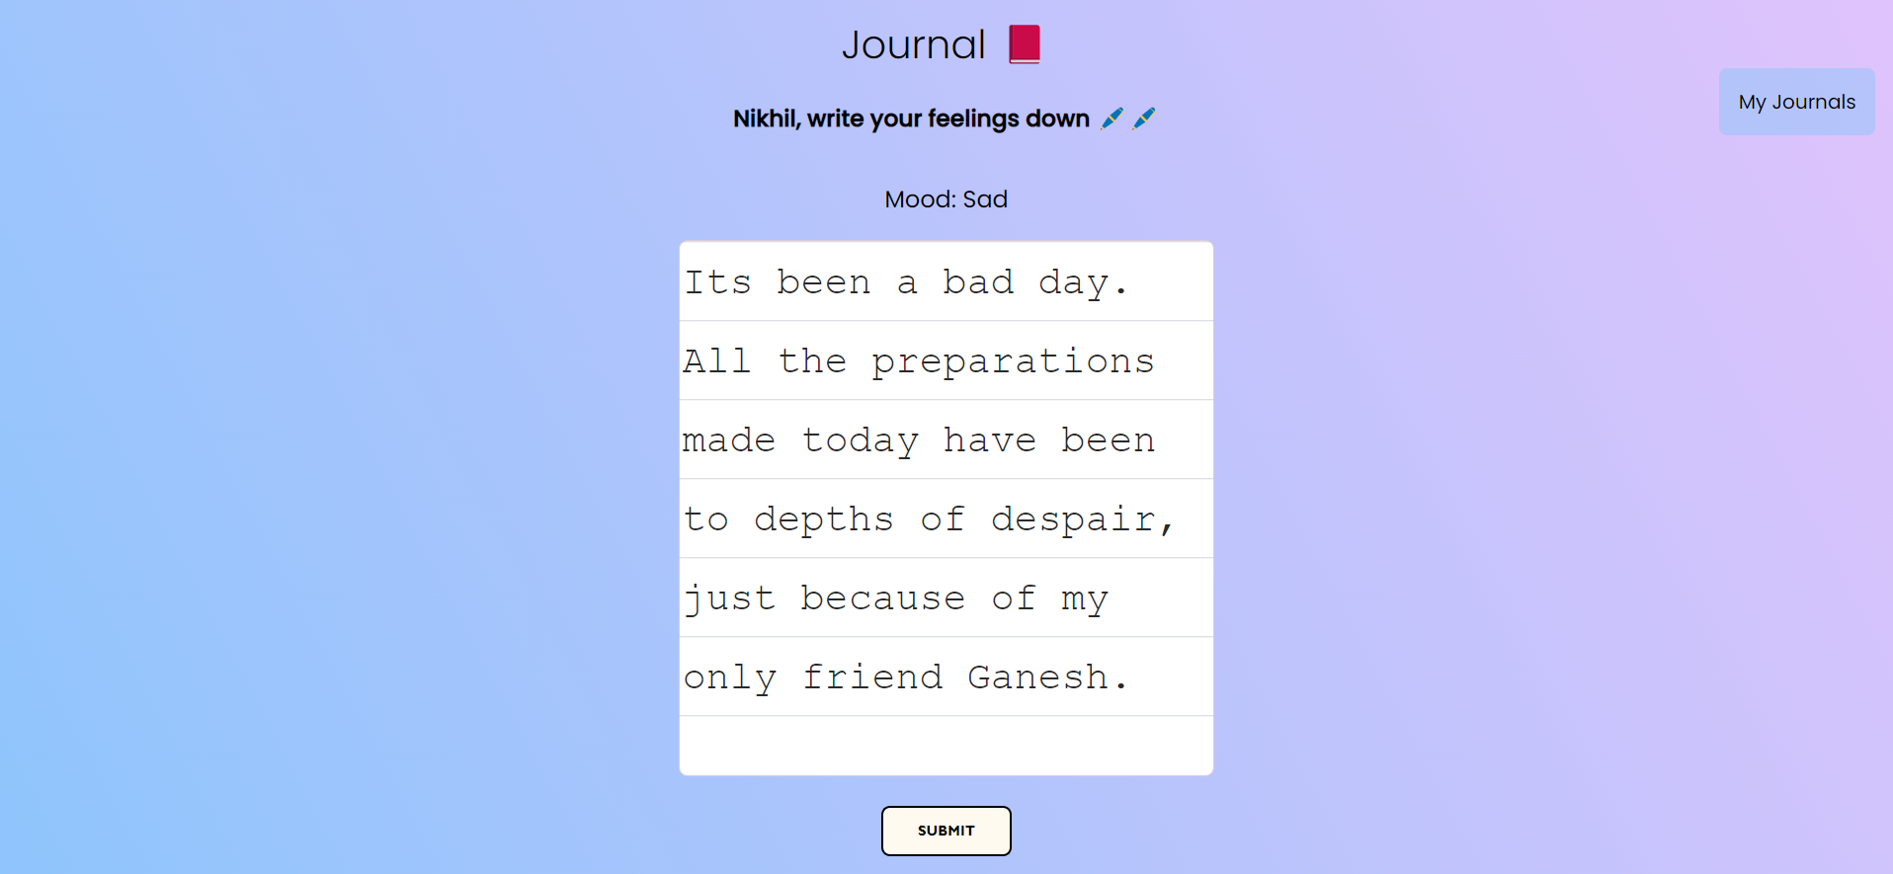
Screenshots…

Slide 21
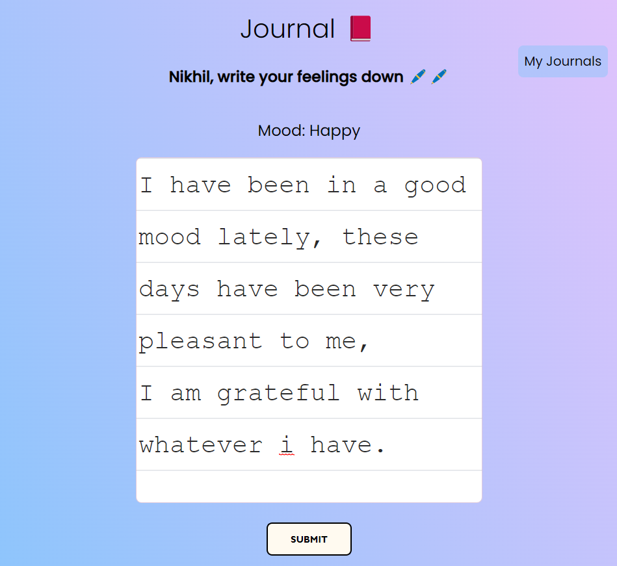
Screenshots…

Slide 22
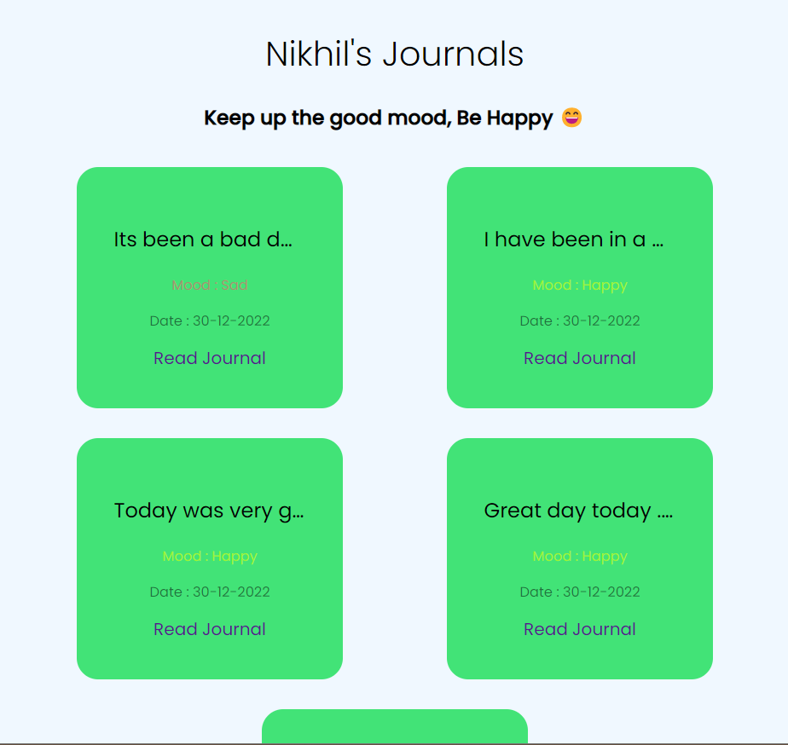
Screenshots…

Slide 23
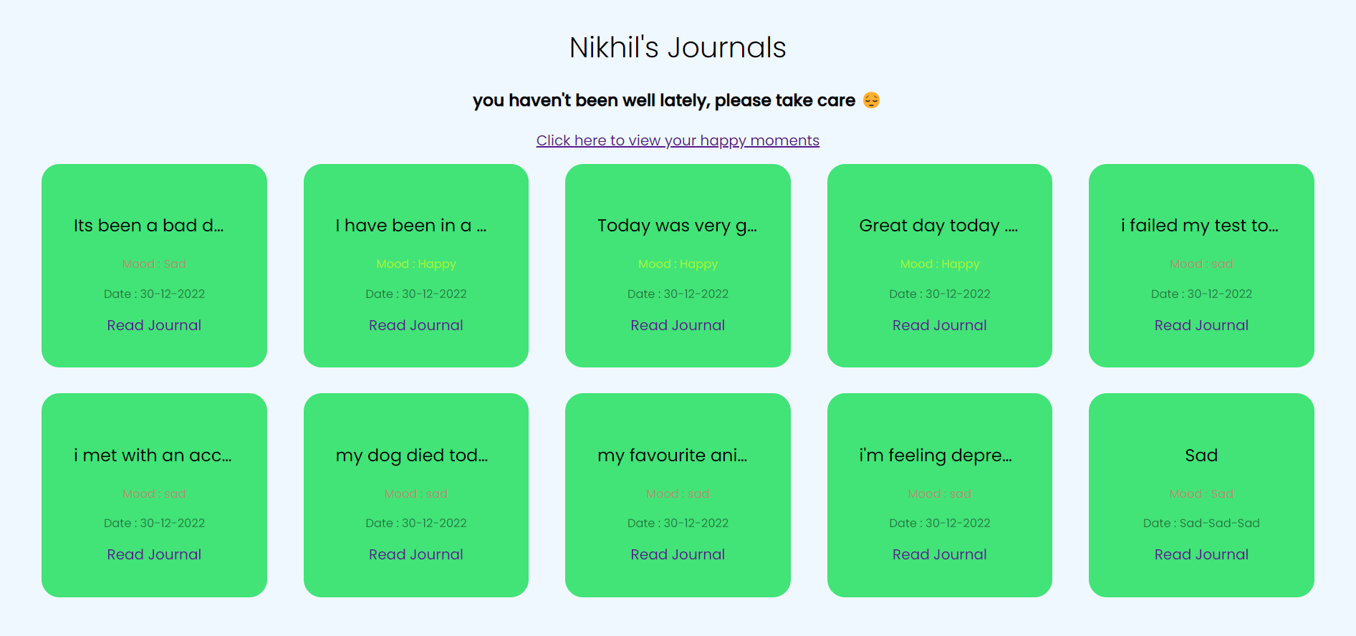
Screenshots…

Slide 24
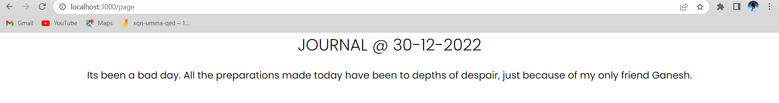
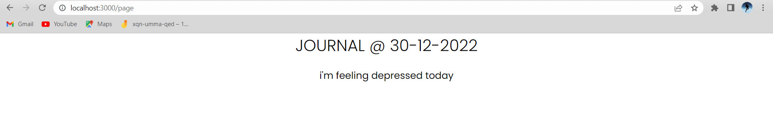
Screenshots…

Slide 25
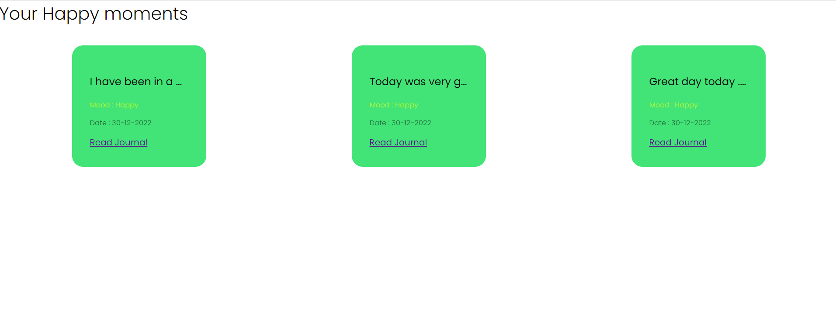
Screenshots…

Slide 26
Future Scope
This application helps in dealing with the mental health problems of ours and younger generation. The plan is to add sleep assistant that helps with sleep by suggesting music and ways to calm down. We will also include real time mood tracker which changes while the journal is being written.

Slide 27
Conclusion !
This application helps users build healthy habits through scientifically backed methods.
This application helps users in practicing gratitude, it allows users to track their happy moments and relieve them later.

Slide 28
Thanks!

